Slide 1
3.4 Web Design Portfolio
Practice Assessment
Jack Olsen

Slide 2
You need to provide evidence showing:
that the website has been trialled and tested regularly throughout the design and development phase
that feedback from each cycle of trialling and testing has been used to improve the website
how you applied user experience principles to improve the quality of the outcome (10 usability heuristics)
efficient tools and techniques that you have used in the websites' production (e.g. editing techniques, one style sheets, shorthand CSS, versioning, etc).

Slide 3
Task 1 : Identify the purpose of your website
The purpose of the website is to promote and sell Suzanne Collins books while also promoting her as an author. I will also give a fresh new look to the website to appeal to more audiences. The websites goal is to help users find out information about her as an author and provide links so they can easily purchase her novels.

Slide 4
Task 2 : Who will be your target audience?
I will be targeting young adults therefore my site needs to appeal to a wide demographic. I want to ensure my page is picked up by google as a search engine so I will need to have detailed meta tags. My page will also need to be responsive.

Slide 5
What are your clients requirements?
Responsive design for use on multiple devices
Integration of original media assets (graphics)
Notes:
What are the specific needs of your client – what

Slide 6
Website Structure
index.html
books.html
interview.html
about.html

Slide 7
Project Management : the key steps
Speak with client
Gather the content (text/imagery)
Create low fidelity sketches of your site
Colour palette and font options should be presented to client
Begin coding site (make changes as you develop it, seek feedback)
Validate the site, add code comments
Use feedback/testing to iteratively improve the quality of your website

Slide 8
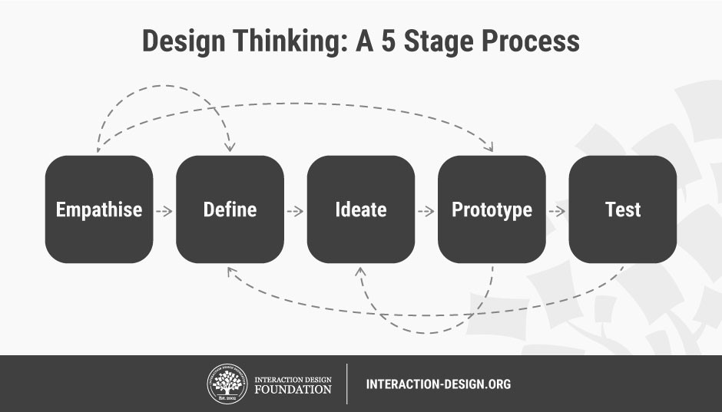

Slide 9
Relevant Implications - Aesthetics
The nav bar should sit at the top of the page and the links should sit either on the left/right hand side of the logo or menu.
Have clear contrast of font e.g white background with black font.
Keep design minimal, use white space to ensure the design is not cluttered.
Rule of thirds - the top third should contain the nav bar and dominant image, the main section should be your main content and the last section should contain a footer with copyright info and links.
Font should be scalable so that it is easy to read across devices.
Notes:
Which 2 -3 will you be focusing on during the creation of your website

Slide 10
Relevant Implications – Sustainability
Code comments to help future coders understand your code.
Use DIV tag rather than HTML5 tags to ensure a consistent and accurate design.
CSS3 is the most up to date style sheet.
Avoid using plugins.
In the footer, note the year the site was created and by whom so user’s know it is up to date and can contact you.
Keep updating content to ensure that your information is correct.

Slide 11
Relevant Implications – Accessibility
Make sure your page can scale across multiple devices e.g tablet, PC and phone using media queries.
Use alt tags on images for blind people.
Meta tags in the head section, give a decent description so the search engines favour your site.
Hyperlinks should be obvious, have hover effects of some kind and should work.

Slide 12
Gather Content
Notes:
Save images to an appropriate name folder
Compress / edit images where need be
Name the files accurately
Record this process

Slide 13
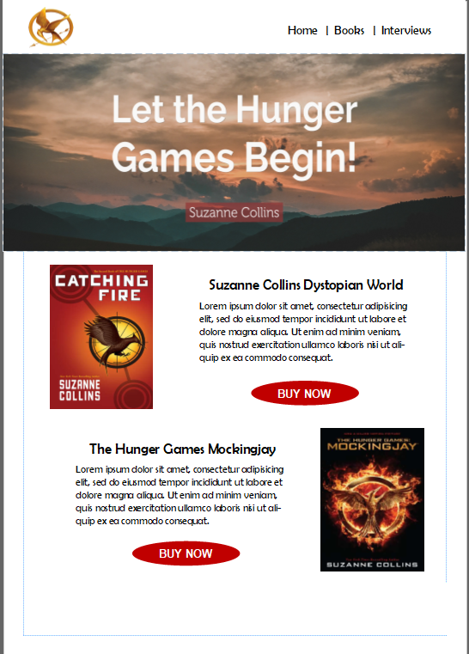
High Fidelity Mock-ups
Notes:
Save images to an appropriate name folder
Compress / edit images where need be
Name the files accurately
Record this process

Slide 14
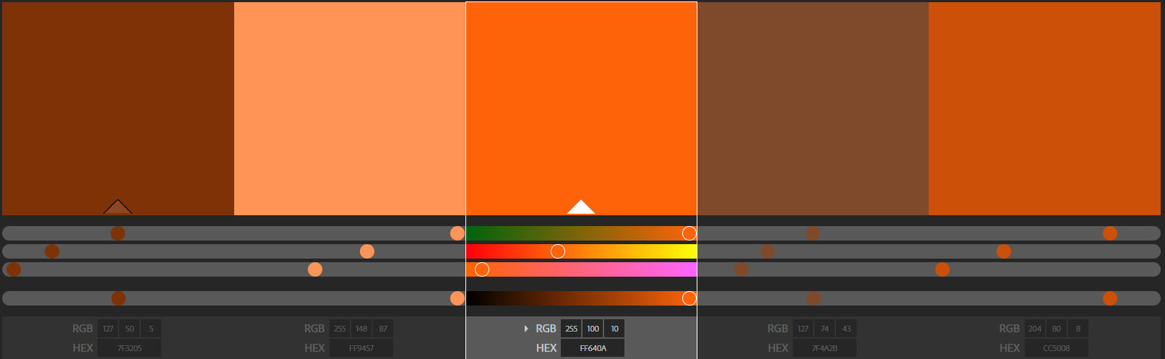
Colour Palette
Black (#000000 or rgb(0,0,0), white(#FFFFFF or rgb(255, 255, 255)) and different shades of orange.
Notes:
Use colours combos

Slide 15
Font Combinations
Montserrat for headers. Esteban for paragraph texts.

Slide 16
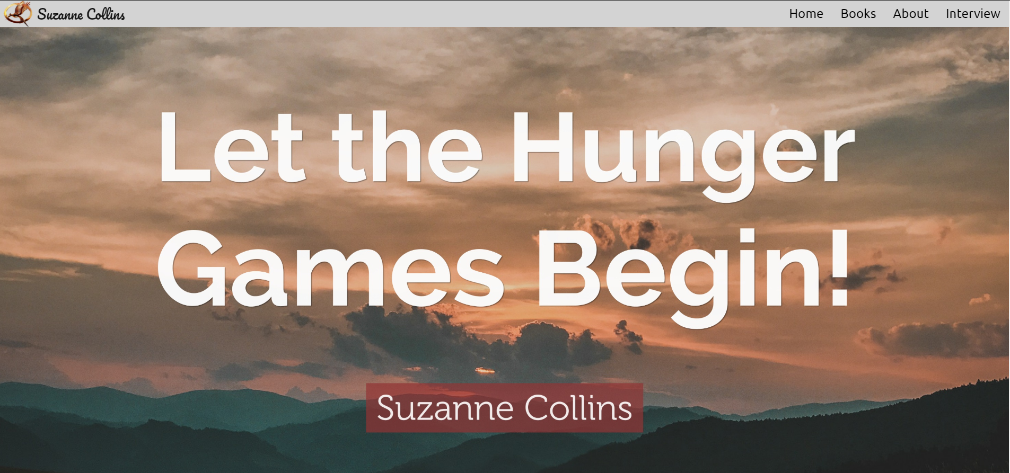
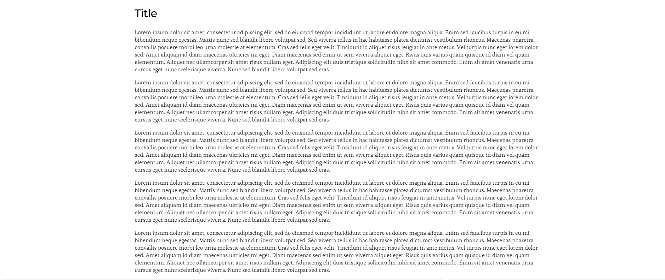
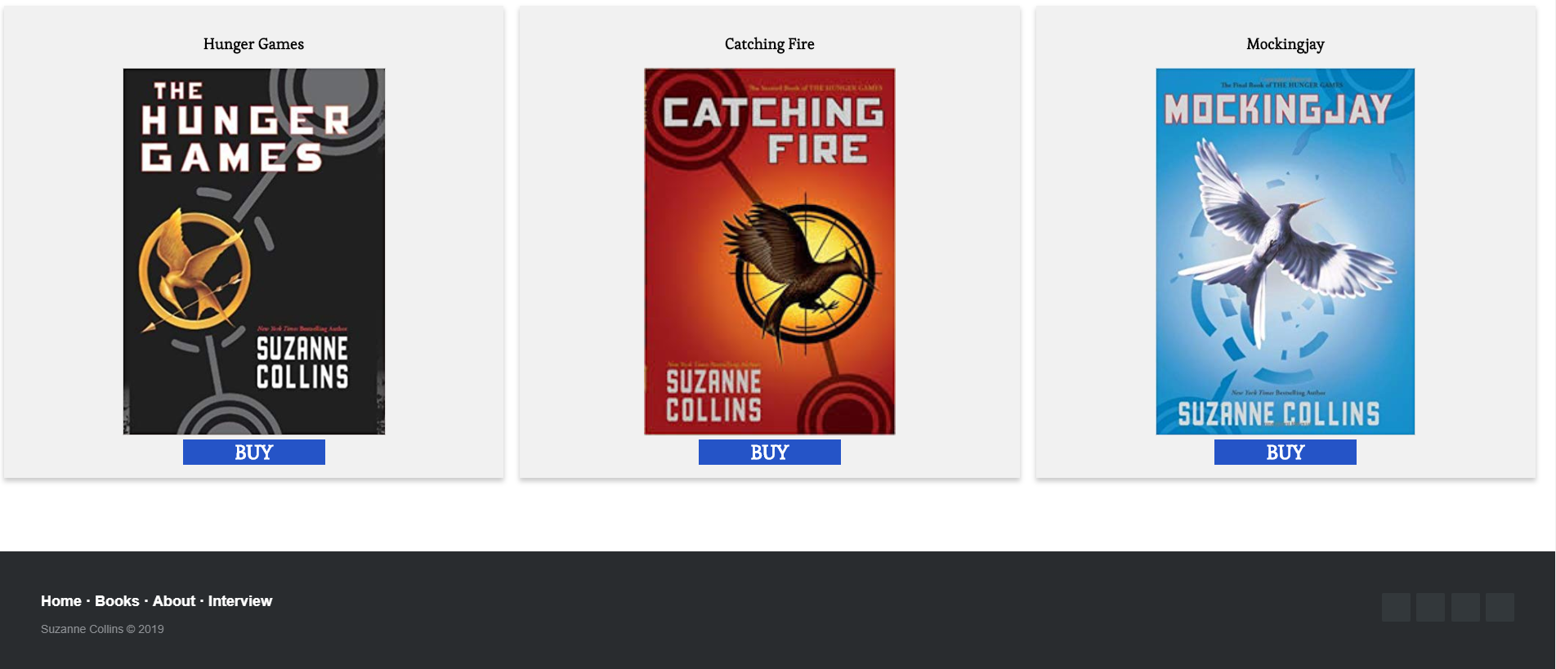
Feedback
Comments:
Nice clear image above the fold, easy to read test
I like the banner image it looks good

Slide 17
A vs B testing
Notes:
Give two different options for font / colours – save the different versions
Screenshot them and get votes for stakeholders

Slide 18
A vs B testing
Notes:
Give two different options for font / colours – save the different versions
Screenshot them and get votes for stakeholders

Slide 19
Data Integrity
Notes:
Data integrity is ensuring the information displayed is up to date , spelled correctly . Do F7 on your word content.
Testing

Slide 20
Testing Procedures
Notes:
Test your site on mobile, tablet and pc view
Validate your website – screenshot the no errors.

